Slide 1

Technology Opportunity Discovery by use of NLP, Naïve Bayes Classifier and word2vec
Presented by Vivek Jacob Chacko
IFT598 – Natural Language Processing (Spring 2020)
Arizona State University

Slide 2
Problem Statement
Current Sentiment Analysis focuses only on whether reviews are positive or negative
Lacks identification of features and their corresponding reviews
Using the research paper by Taeyeoun Roh, Yujin Jeong, Hyejin Jang, Byungun Yoon from Dongguk University, Seoul, South Korea
We aim to identify reviews pertaining to given technological/product features

Slide 3
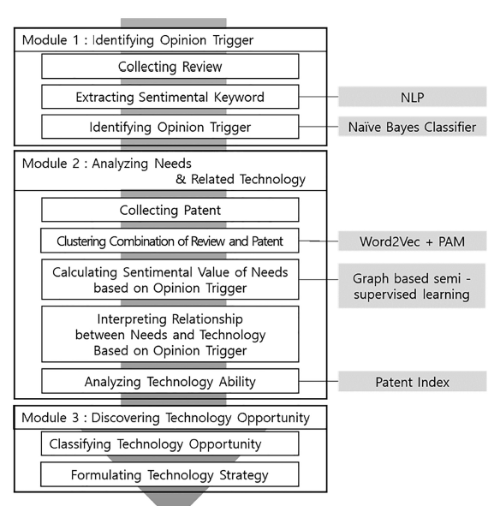
Proposed Solution by Research Article
The proposed solution suggests the following steps:
Module 1 Identifying Opinion Triggers
Module 2 Analyzing Needs & Related Technology
Module 3 Discovering Technology Opportunity

Slide 4






Data Set
For our dataset we originally started with Amazon Cell Phone Reviews from Kaggle Kaggle Amazon Cellphone Reviews - Dataset Source
This was eventually changed to a custom dataset obtained by scrapping iphone se reviews from popular review websites

Slide 5
Data Set
For our dataset we originally started with Amazon Cell Phone Reviews from Kaggle Kaggle Amazon Cellphone Reviews - Dataset Source
This was eventually changed to a custom dataset obtained by scrapping iphone se reviews from popular review websites

Slide 6
Areas of focus
Data Cleansing
Lemmatization
POS-tagging
Sentiment Analysis
Naïve Bayes Classifier
Word2vec
Dependency Parsing

Slide 7
Data Scrapping & Cleansing
Reviews scrapped from websites
Removal of non review parts such as further reading section, copyright information, etc
Removal of line breaks, tabs
Removal of Image description, etc
Converting corpus to csv for use with python (pandas)

Slide 8
Structure of a sentiment
adjective/adverb + verb + noun
{sentiment keyword} + {object opinion trigger} + {functional opinion trigger}

Slide 9

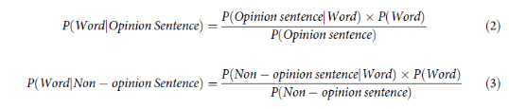
Naïve Bayes

Slide 10
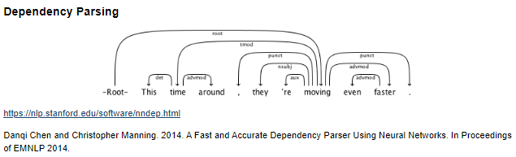
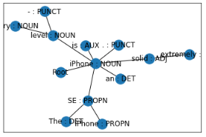
Dependency Parsing

Slide 11
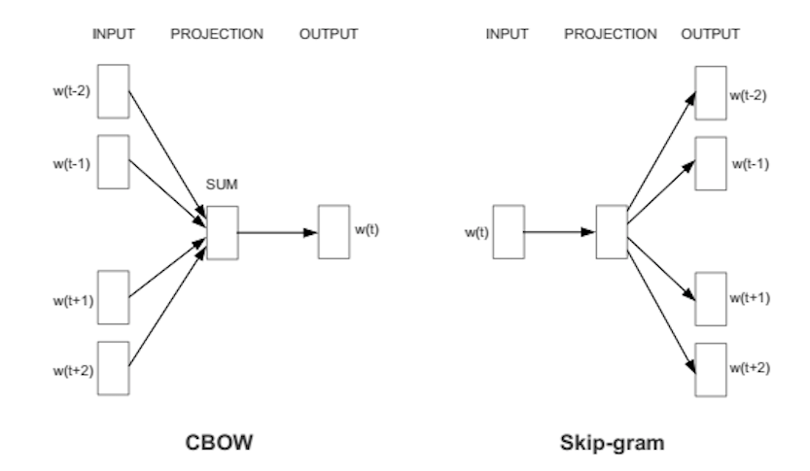
Word2vec

Slide 12
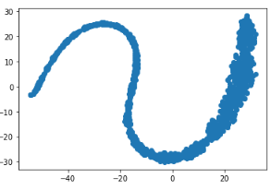
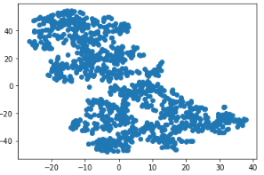
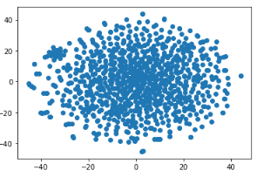
word2vec
5 iterations 50 iterations 1000 iterations

Slide 13
SOME OF THE Results
The following sentiments were observed for each functional opinion trigger
photos ['animated', 'realistic', 'smarthdr', 'medium', 'smooth', 'closely’, 'pleasing', 'outdoor', 'functional', 'suddenly', 'awesome', 'podcast’, 'unnecessary’, 'constantly']
battery ['slightly', 'majorly', 'attractive', 'fantastic', 'certainly', 'negative', 'early’, 'efficient', 'stellar', 'mixed', 'stereotypical']
price ['attractive', 'fantastic', 'third', 'understandable’]
display ['slightly', 'fancy', 'personal', 'lovely’]
video ['cramped', 'extended', 'looped', 'mobile', 'continuously', 'frequently’, 'dynamic', 'local']

Slide 14
SOME OF THE Results
Opinion trigger similarity grouping
iphone ['iphone', 'se’]
mode ['mode', 'portrait', 'night', 'slofies', 'airplane', 'fusion', 'friends', 'filming’, 'panorama', 'options', 'pets', 'captures’]
id ['id', 'touch', 'face', 'benefits', 'verification', 'feeling', 'nfc']

Slide 15
Modifications to existing solution
Factors that required change in existing solution
Inconsistent data
Availability of better solution
Things explored
Dependency Parsing
Stanford’s NLP (Stanza) to display a graph representation of sentences

Slide 16
Future possible improvements
Lemmatizing the words in sentiment keywords and FOT/OOT
Using a larger dataset
Using Dependency Parsing to group words together

Slide 17
Lessons Learnt
Importance of clean data
Accuracy of models is critical
Several readily available frameworks
Importance of visualization

Slide 18
Thanks!

